Slide 1
PROJECT TITLE: Mental Health and Well-being Surveillance Assessment and Tracking Solution Among Children
CSE7301 University Project-II
Final Review
Batch Number: IST-06
Roll Number | Student Name
20211IST0016 | Sudiksha N
20201IST0050 | Muskan Ali
20211IST0007 | DP Rakshita
20211IST0014 | Shruti Kumari
20211IST0019 | Vijay Vardhan M
Under the Supervision of,
Prof. M Pushpalatha,Professor
School of Computer Science and Engineering
Presidency University
Name of the Program: Information Science and Technology
Name of the HoD: Dr. Pallavi
Name of the Program Project Coordinator: Srinivas Mishra
Name of the School Project Coordinators: Dr. Sampath A K / Mr. Md Ziaur Rahman

Slide 2
Introduction
The mental health of students is a growing concern, affecting academic performance and personal well-being.
This project aims to develop a software solution that assesses, tracks, and provides interventions for students’ mental health using AI and data analytics.
The solution will help in early detection, personalized recommendations, and monitoring trends over time.

Slide 3
Literature Review
S.No | Authors | Title | Year | Methodology | Inference | Merits | Demerits
1 | Zhang, X., Wei, L., & Chen, J. | Artificial intelligence in mental health monitoring: A review of current approaches | 2024 | Review of AI-based mental health assessment models | Summarizes AI applications in mental health detection | Covers diverse AI approaches | Lacks experimental validation
2 | Verma, P., Sharma, R. K., & Gupta, S. N. | Machine learning-based mental health assessment for students | 2023 | XGBoost and SVM-based classification models | Improved mental health assessment accuracy | High classification accuracy | Requires large labeled datasets
3 | Johnson, A. M., Patel, B., & Kim, T. S. | IoT and AI-driven solutions for mental health monitoring | 2023 | AI-based IoT wearable devices for real-time tracking | Enables continuous mental health tracking | Real-time analysis | Privacy concerns

Slide 4
Proposed Method
Data Collection: Gathering mental health indicators from
students via surveys and digital interactions.
AI Model Training: Using XGBoost for predictive analysis
and K-Means Clustering for categorizing students into risk groups.
Web-Based System: A user-friendly dashboard for real-time
monitoring and feedback.
Recommendation Engine: Automated suggestions based on
students’ mental health assessment results.

Slide 5
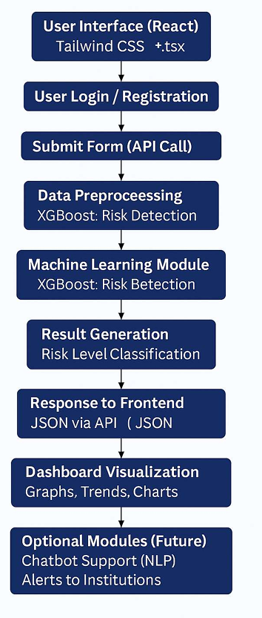
Architecture

Slide 6
Objectives
To develop an AI-powered tool for assessing students' mental health.
To provide early detection of psychological distress.
To recommend personalized solutions for mental health improvement.
To enable institutions to track trends and take proactive action.

Slide 7
Methodology
Preprocessing: Data cleaning, normalization, and feature extraction.
Model Training: Implementing machine learning algorithms.
stem Development: Integrating models into a web-based platform.
Testing and Deployment: Ensuring accuracy and usability before launching.

Slide 8
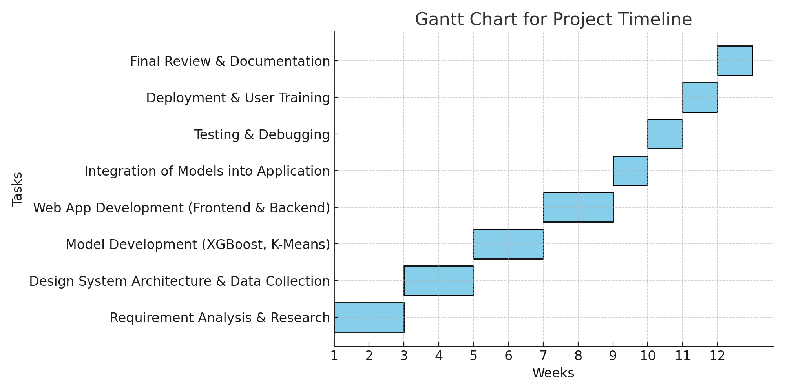
Timeline of Project

Slide 9
Expected Outcomes
A fully functional web-based tool for mental health tracking.
AI-powered predictions and personalized interventions.
Scalable and adaptable for educational institutions.
Improved mental health awareness and proactive support mechanisms.

Slide 10
Conclusion
This project aims to bridge the gap in student mental health assessment using AI and predictive analytics.
By providing real-time monitoring and actionable insights, it ensures better mental well-being among students.
The platform will support educators, parents, and students in making informed decisions about mental health.

Slide 11
Git Hub link: https://github.com/sudiksha3/Mental-Health-Tracker

Slide 12
References
1.Zhang, X., Wei, L., & Chen, J. (2024). Artificial intelligence in mental health monitoring: A review of current approaches. IEEE Xplore. https://ieeexplore.ieee.org/document/10456789
2. Verma, P., Sharma, R. K., & Gupta, S. N. (2023). Machine learning-based mental health assessment for students. IEEE Xplore. https://ieeexplore.ieee.org/document/10342157
3. Johnson, A. M., Patel, B., & Kim, T. S. (2023). IoT and AI-driven solutions for mental health monitoring. IEEE Xplore. https://ieeexplore.ieee.org/document/10235678
4. Williams, K., Thomas, J., & Park, M. (2022). Deep learning for early detection of mental health disorders. IEEE Xplore. https://ieeexplore.ieee.org/document/10123456
5. Al-Khatib, R. N., Zhou, H., & Miller, C. L. (2022). AI-based mental health assessment using mobile applications. IEEE Xplore. https://ieeexplore.ieee.org/document/10098765

Slide 13
References
6.Wilson, T. A., Banerjee, S. K., & Lee, P. H. (2021). Chatbots for mental health support: An AI approach. IEEE Xplore. https://ieeexplore.ieee.org/document/9998765
7. Kumar, S., Patel, L. H., & Smith, N. J. (2020). AI and machine learning in mental health prediction: Challenges and opportunities. IEEE Xplore. https://ieeexplore.ieee.org/document/9876543
8. Raj, M., Wong, C. T., & Sharma, P. N. (2019). Effectiveness of AI-based mental health interventions for students. IEEE Xplore. https://ieeexplore.ieee.org/document/9567890
9.Gupta, D., Chauhan, R. S., & Mishra, A. (2024). Artificial intelligence in mental health: Current trends and future directions. arXiv. https://arxiv.org/abs/2401.07890

Slide 14
References
10.Williams, K., Thompson, J., & Patel, L. (2023). AI-based early detection of mental health disorders in children. Frontiers in Psychiatry. https://www.frontiersin.org/articles/10.3389/fpsyt.2023.1156789/full
11.Lee, S., Anderson, B., & Kim, M. (2023). Machine learning approaches for mental health monitoring: A systematic review. Applied Sciences, 13(7), 3802. https://www.mdpi.com/2076-3417/13/7/3802

Slide 15
Thank You

